Slide 1
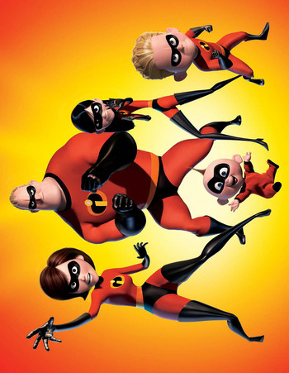
can you help
the Incredibles
save the world?
start
earth
space shuttle
robot
home
Pluto
back to start
back to start
space
+3
aliens
moon
game rules:
you must land on the square with the ladder to go up or down.
you must use English.
you must land on finish.
FINISH
stars
Saturn
-2
-2
-1
Korea
-4
+2
Mars

Slide 2
